Slide 1
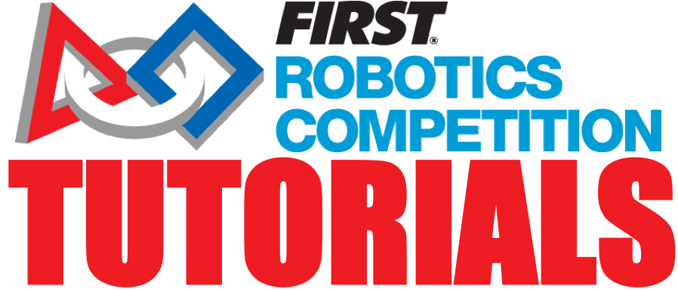
Doing Outreach
Alex Ronnebaum
FIRST Alum & FRC 128 Coach

Slide 2
What is Outreach?
Outreach is when a team reaches out to a community or group and provides some sort of service, usually fun and engaging STEM activities.
Outreach does not only have to be STEM focused, though. Many teams do community service activities every season.
A key part of outreach is meeting the community or group where they are not where you are.
Outreach is essential to FIRST’s mission and enables teams to make a huge impact on not just their communities, but communities everywhere!

Slide 3
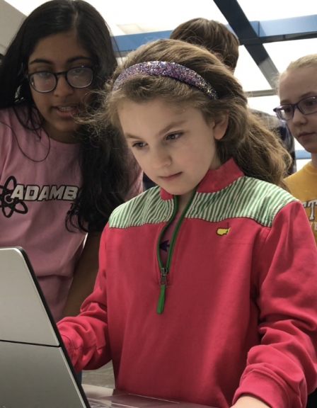
The Importance
FIRST students are 3x more likely to show an increase in STEM interest than other students.
Outreach is a great way for teams to connect with their community and make a lasting impact on so many kids through FIRST.
Sometimes, the only access children have to engaging educational experiences is during the school day.
Bringing fun and interesting activities to students provides not only countless opportunities for their future, but increases their self-confidence.

Slide 4
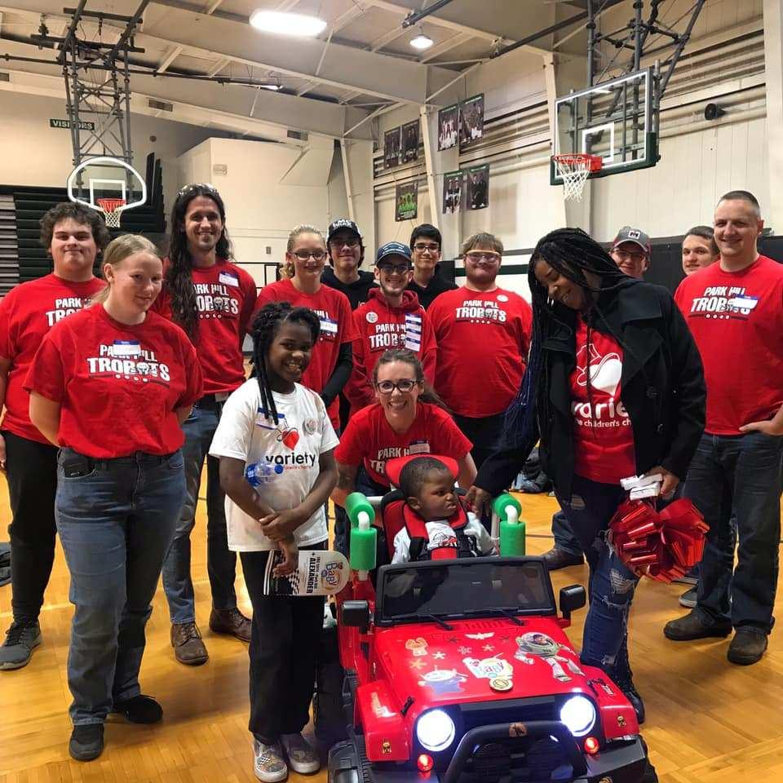
How do we Find Events?
Events are everywhere!
Possible avenues for outreach:
libraries
schools
festivals & conventions
volunteering
sporting events
online lessons
summer camps
tabling / booths
even your own shop!
Outreach is what you make it and anywhere there people, there exists a possibility for outreach.

Slide 5
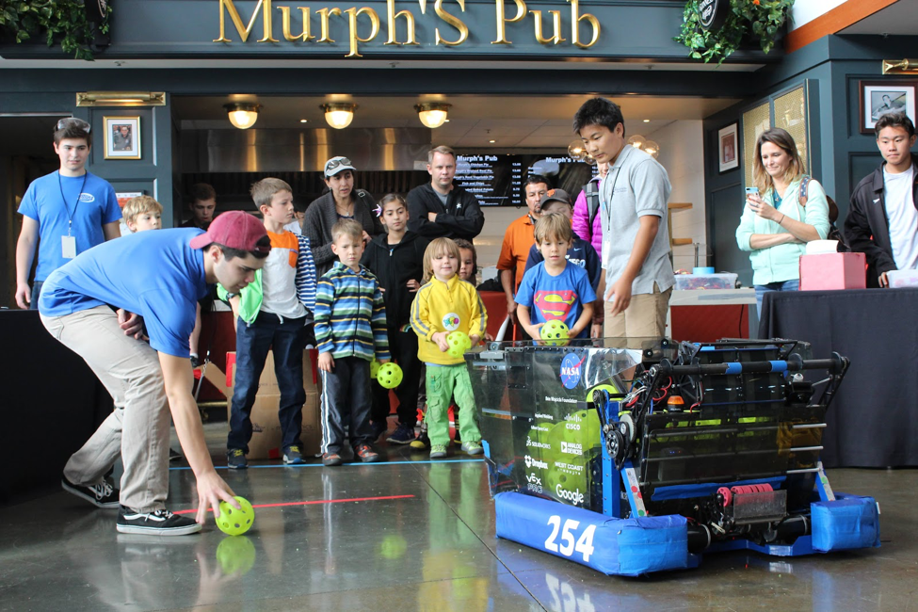
Public Community Spaces
Public community spaces include spots like libraries, rec centers, youth buildings, parks, and other places open to the public.
Reach out to the building manager/owner and they generally love having FIRST teams come in to do outreach!

Slide 6
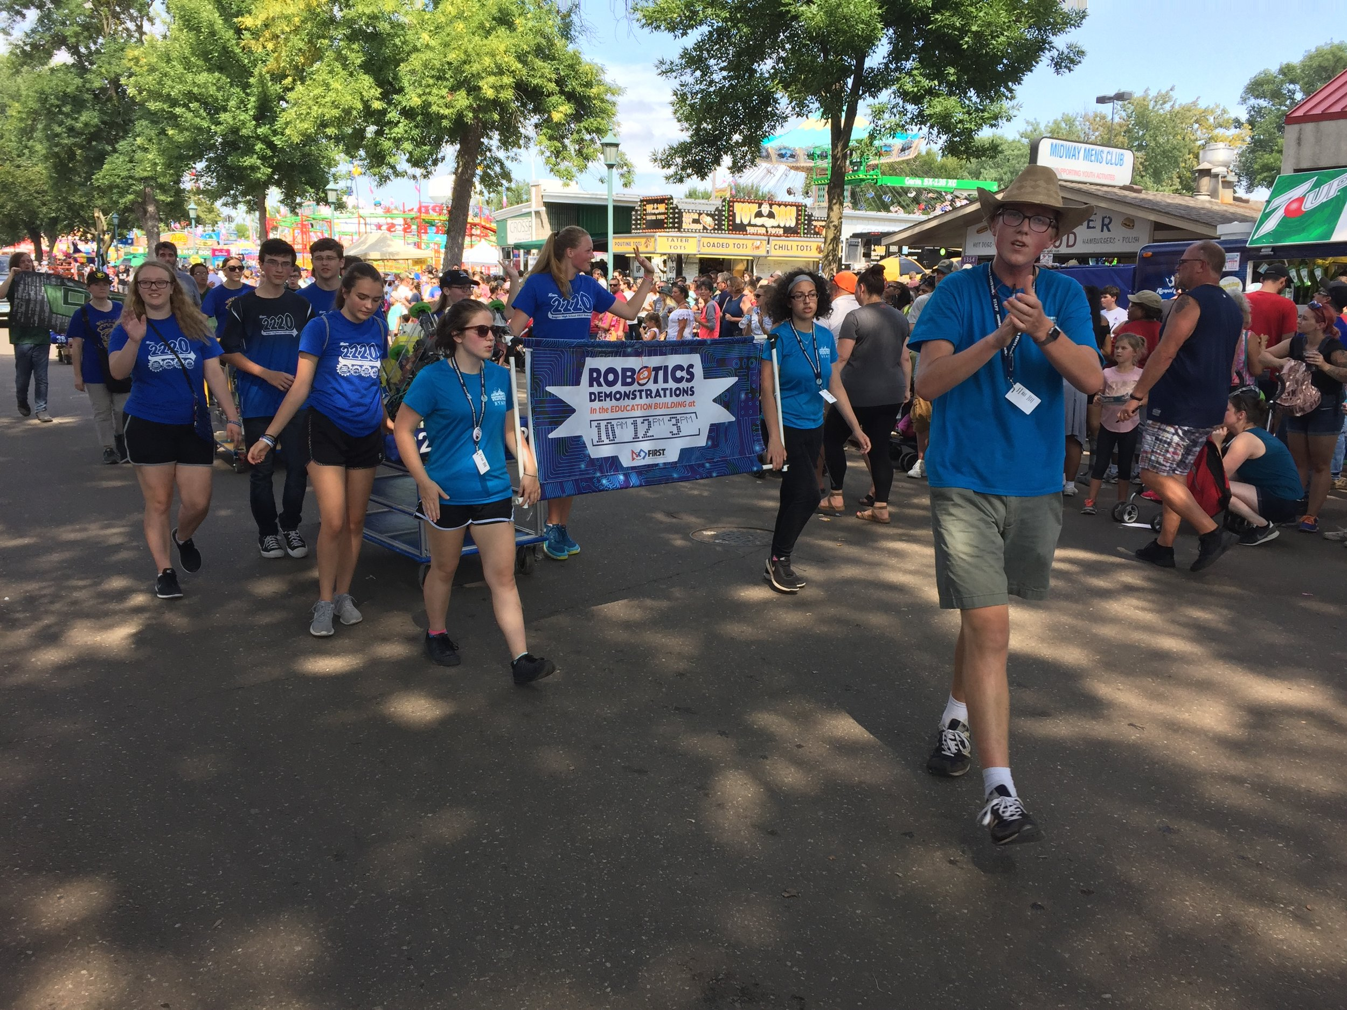
Large Events and Festivals
Many cities have large annual events, these are great places for outreach!
Contact the event coordinator and usually you will be asked to reserve a booth or event slot of some sort.

Slide 7
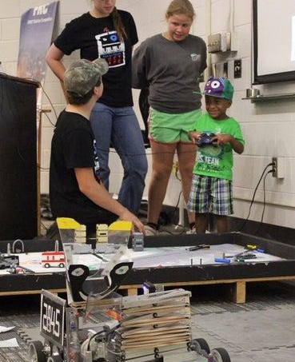
Schools and After-School Programs
Demoing* your robot at school events is not just a great outreach event, but a great recruiting tool, as well.
If your school has any STEM-focused after-school programs, this is a good place to present/demo your robot.
Many schools have activity fairs for students to get involved with co-curricular activities, these are amazing places to spread FIRST.
*Demoing is when a team brings a robot to an event to show what an FRC robot is and what it can do. It is generally encouraged to let event participants operate your team’s robot as well.

Slide 8
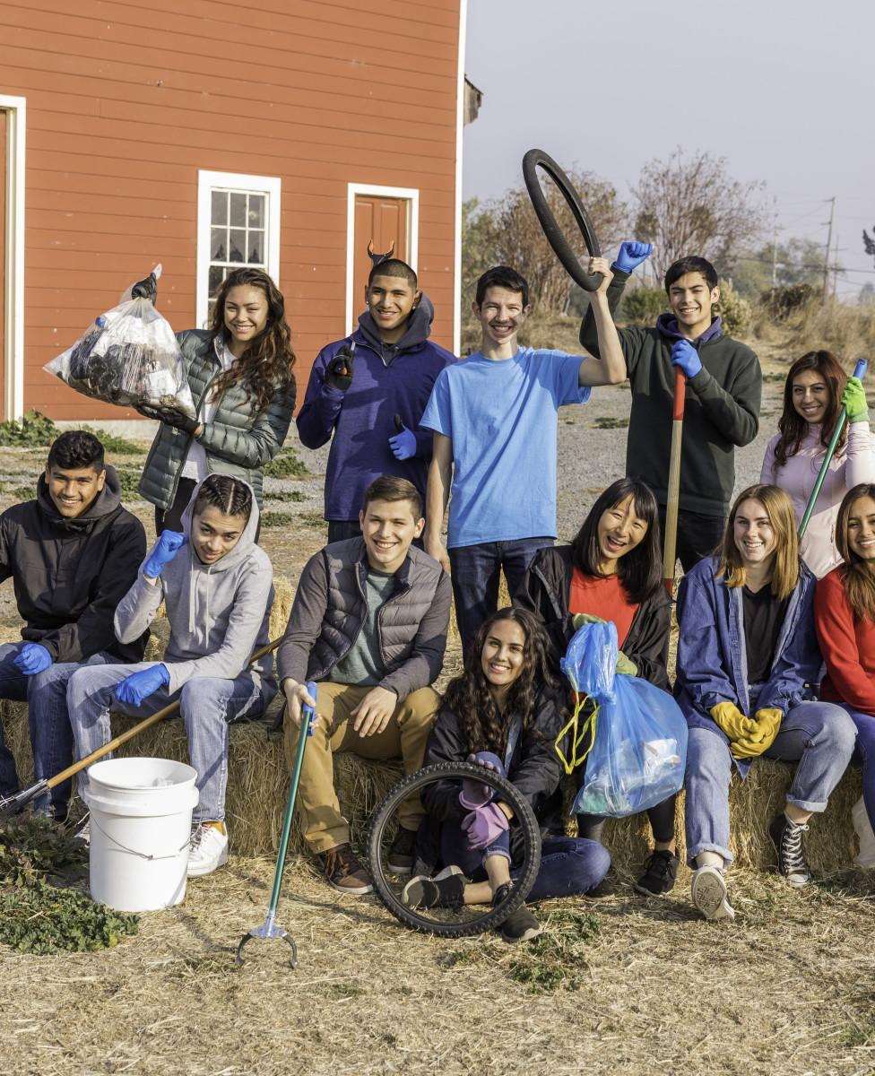
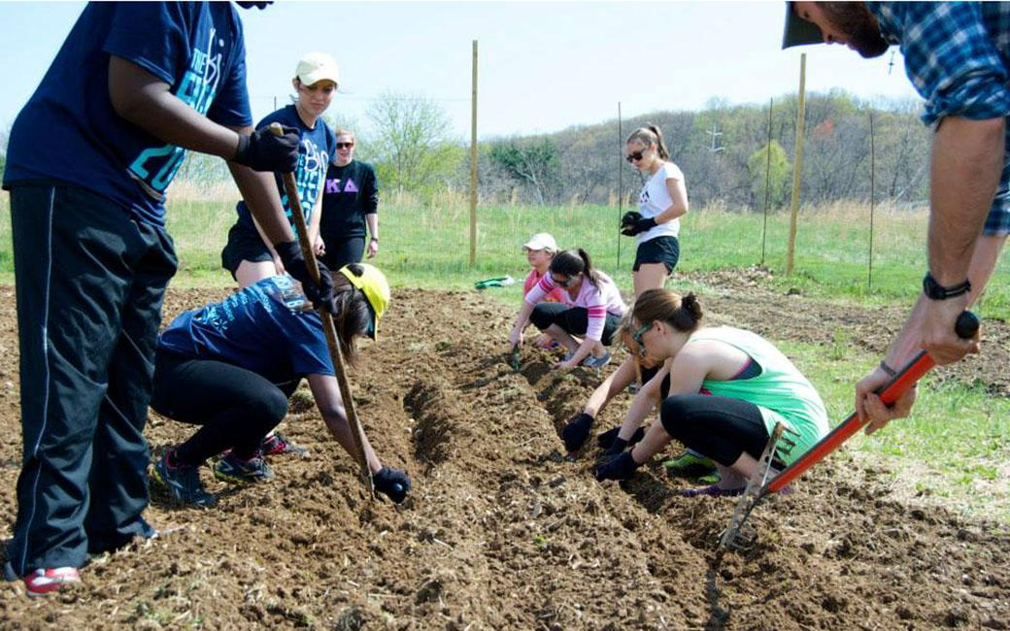
Community Service
There are an infinite amount of ways to volunteer within your community and these events are great ways to have a positive impact and increase FIRST awareness.
Plus, volunteering is a ton of fun!

Slide 9
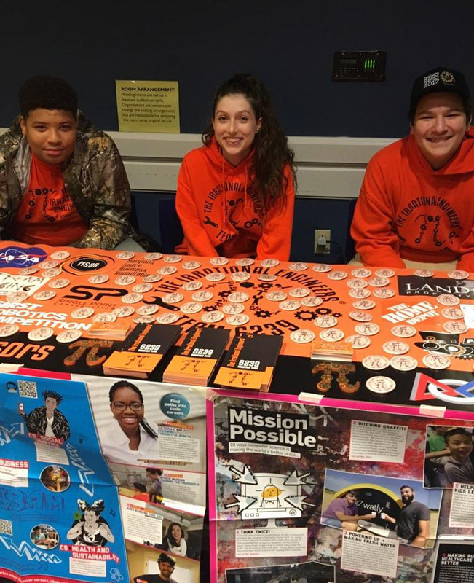
What do we bring?
At events, you will generally have a designated space.
Good items to have are:
team information (flyers, business cards, brochures)
robot and accessories (batteries, charger, laptop, basic tools, etc)
spirit wear (stickers, buttons, pens, bracelets, etc)
The most important thing to bring is students who are ready to inspire others and have a ton of fun!

Slide 10
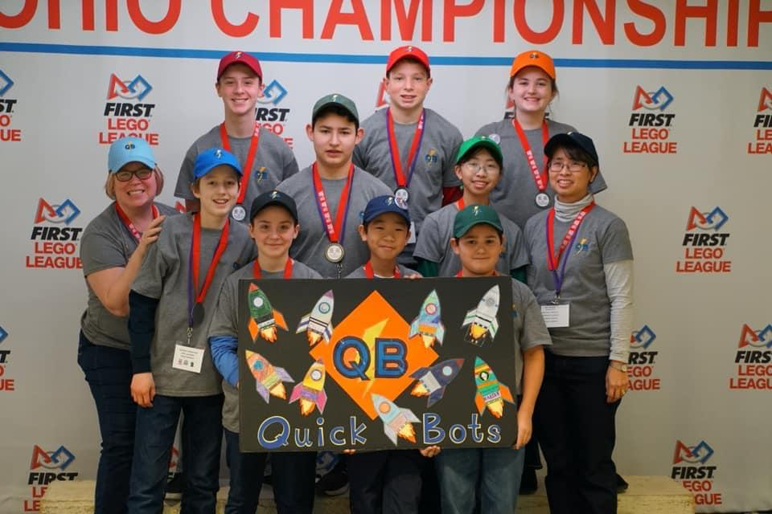
What do we talk about?
Students and parents are generally drawn in by the robot, but it is important to make sure they know that FIRST is so much more than just robots. Talk about all the different projects you’ve gotten to work on.
A good strategy is to talk about positive experiences you’ve had as a part of your team. The more you can talk about all of the useful skills you’re learning as a part of your team, the more interested other people will be.

Slide 11
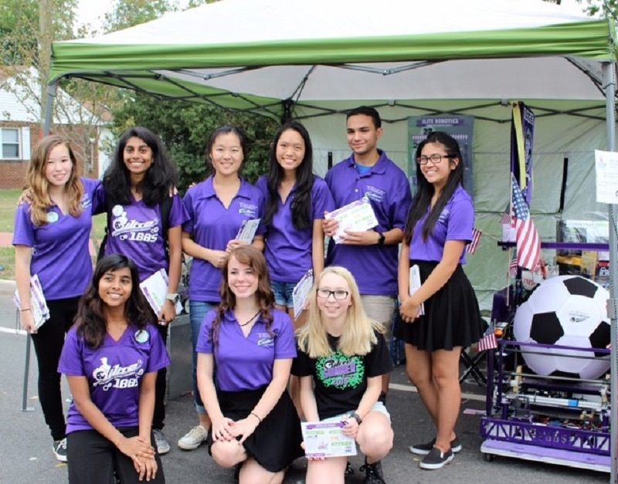
Quick Tips
Always display Gracious Professionalism with everything you do, inside and outside of FIRST events.
The goal at outreach events is not to recruit for only your team, but for FIRST. Find individual solutions for individual students.
Let the students be hands-on with the robot or other demonstrations.
Make safety your top priority.
HAVE FUN!

Slide 12
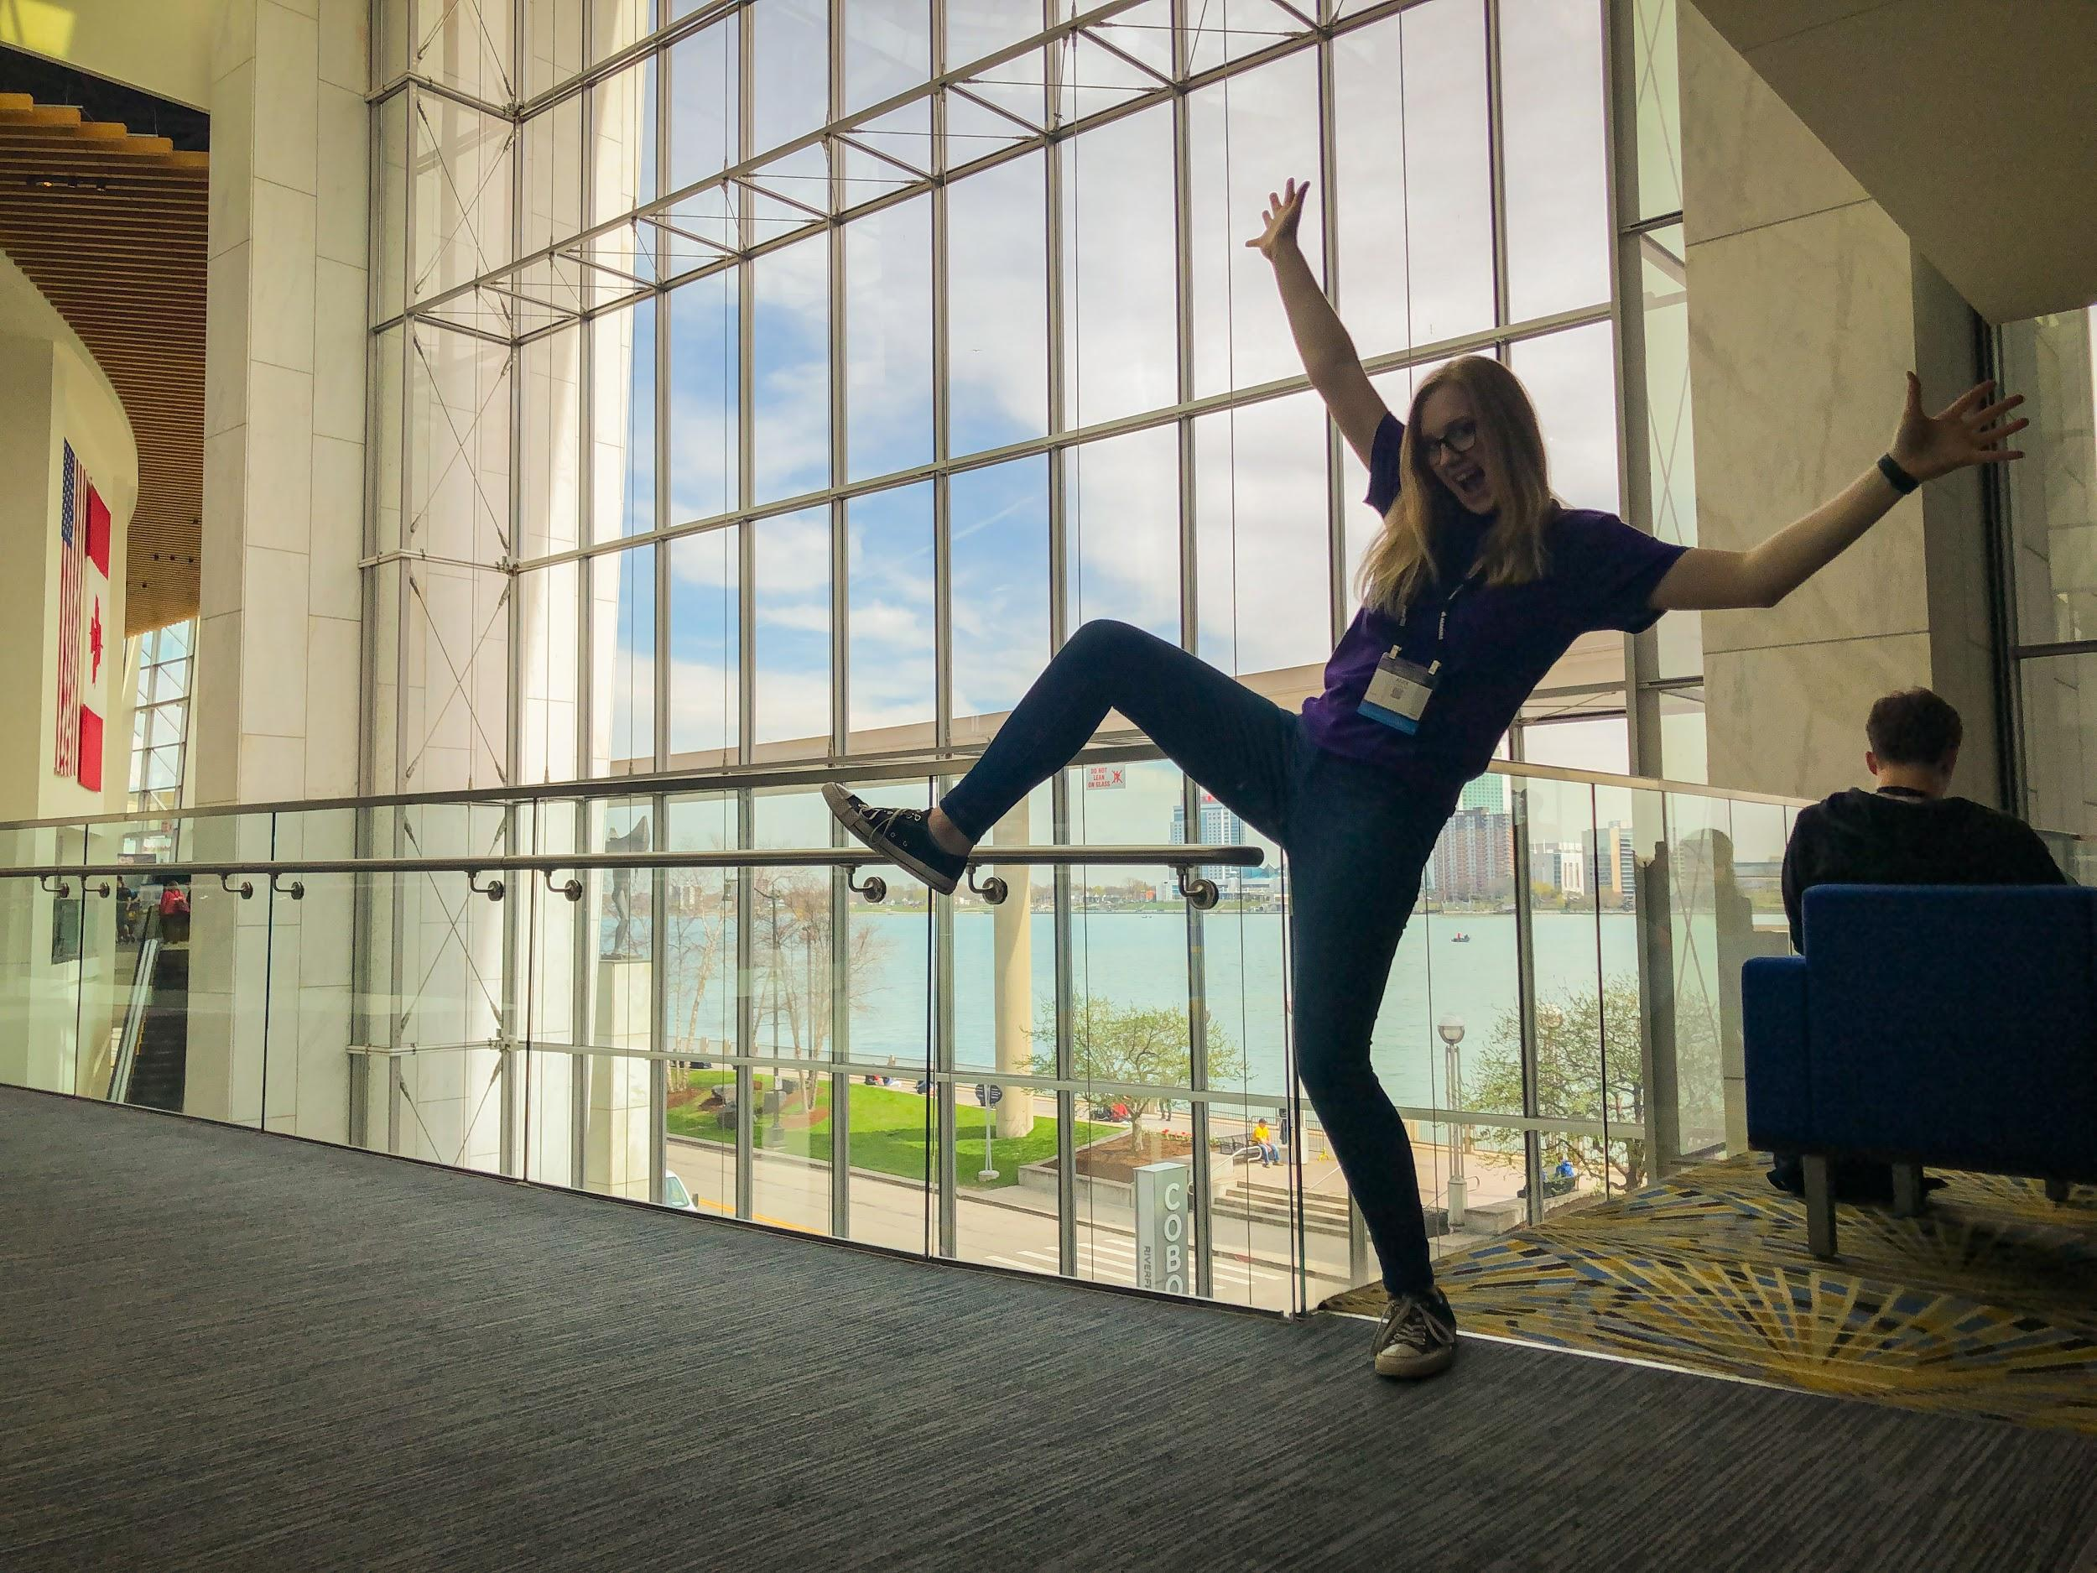
Credits
This lesson was written by Alex Ronnebaum for FRCTutorials.com
You can contact the author at ronnebaum.ab@gmail.com
More lessons for FIRST Robotics Competition are available at www.FRCtutorials.com
This work is licensed under a
Creative Commons Attribution-NonCommercial-ShareAlike 4.0 International License.

